Slide 1
Liverpool - Real Madrid
UEFA Champions League (Final)
Saturday May 28, 2022
“Stade de France”, Paris, France

Slide 2
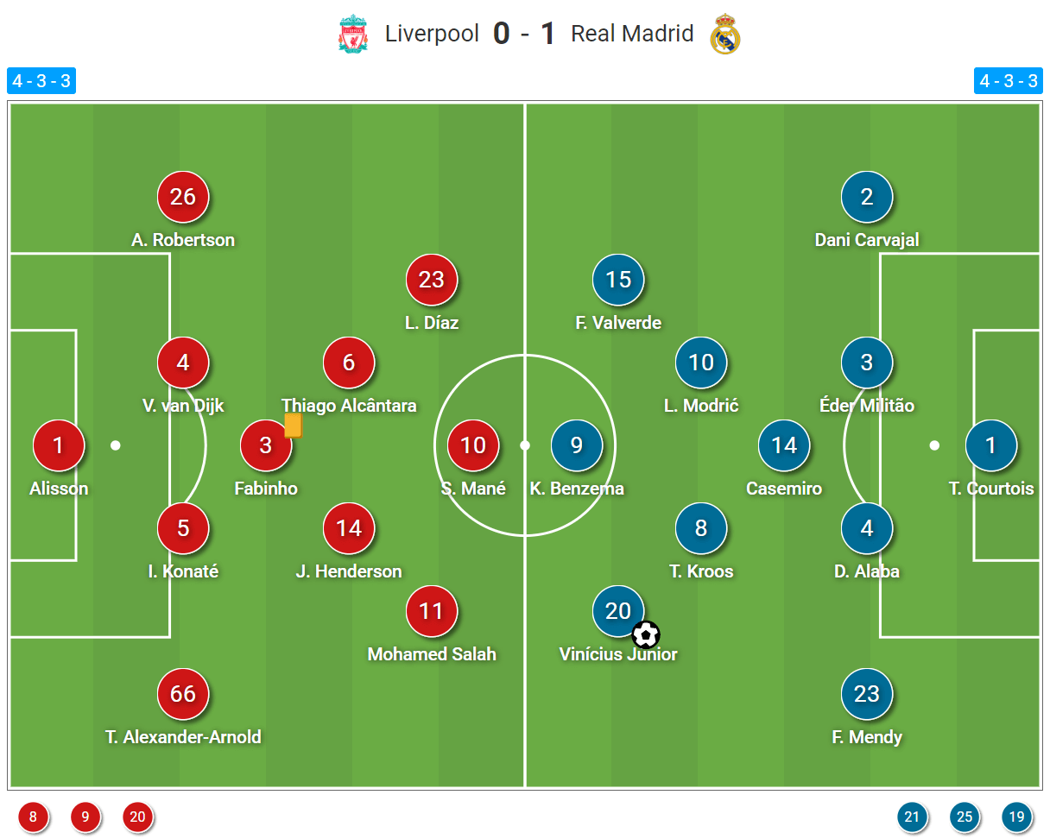

Slide 3
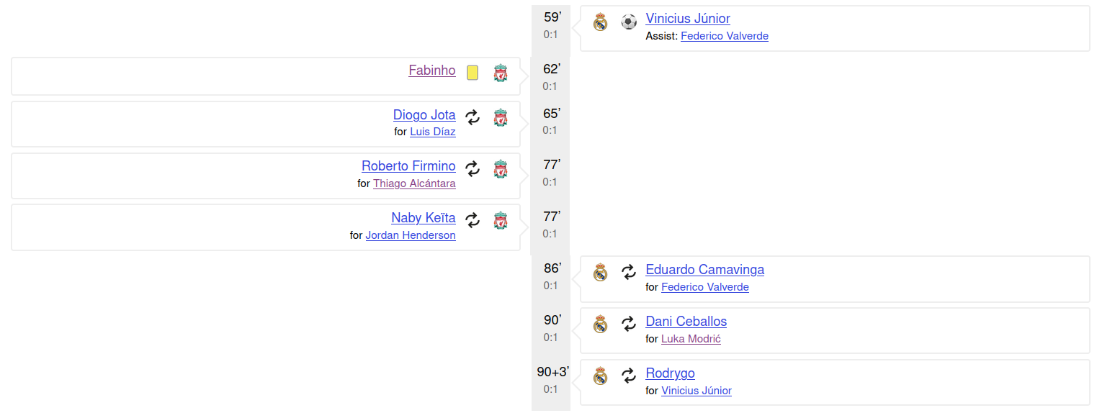
Match events

Slide 4
Basic match facts
 | Liverpool | Real Madrid
Goals | 0 | 1
xG | 2.2 | 0.9
PSxG | 2.5 | 0.41
Shots | 24 | 4
Win probability* | 68% | 11%

Slide 5
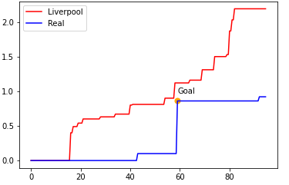
xG during the match
Proposition: did goal came after drop of intensity of Liverpool?

Slide 6
Win probability
Monte-Carlo method
random outcome of each shot based on xG
1,000,000 simulations!

Slide 7
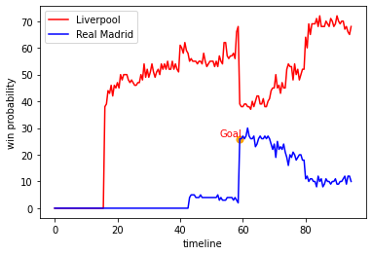
Winning probability during the match
Drawback: doesn’t consider game state.

Slide 8
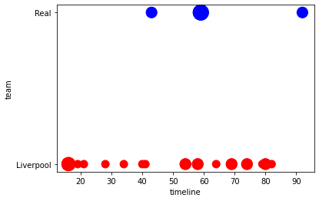
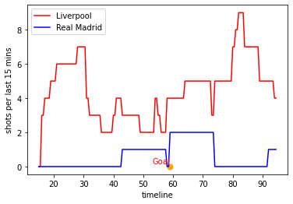
Shot density: 15 mins

Slide 9
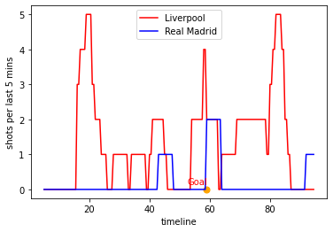
Shot density: 5 mins

Slide 10
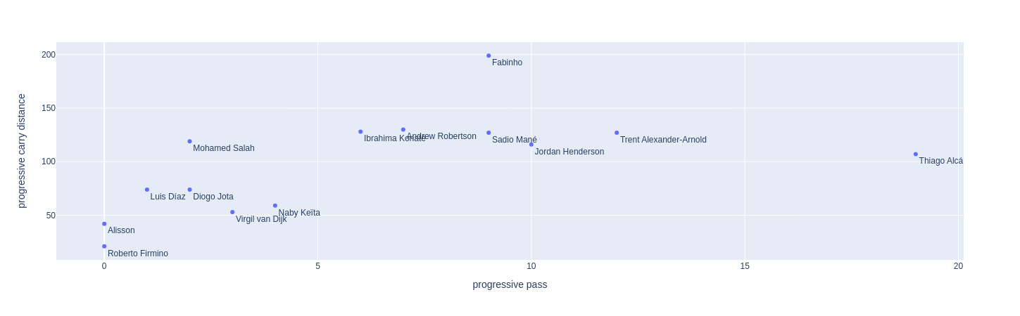
Progression stats: Liverpool

Slide 11
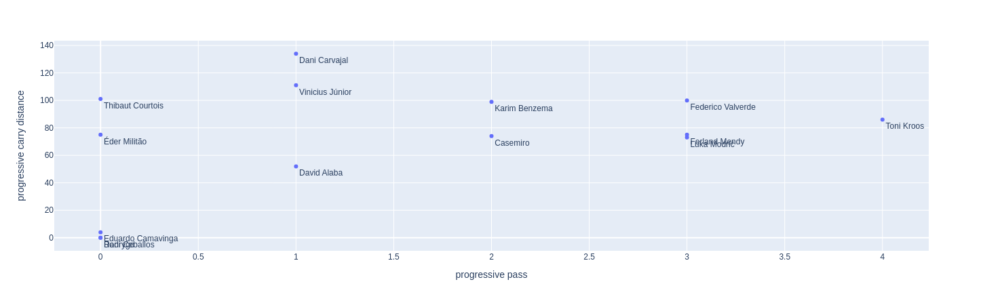
Progression stats: Real Madrid

Slide 12
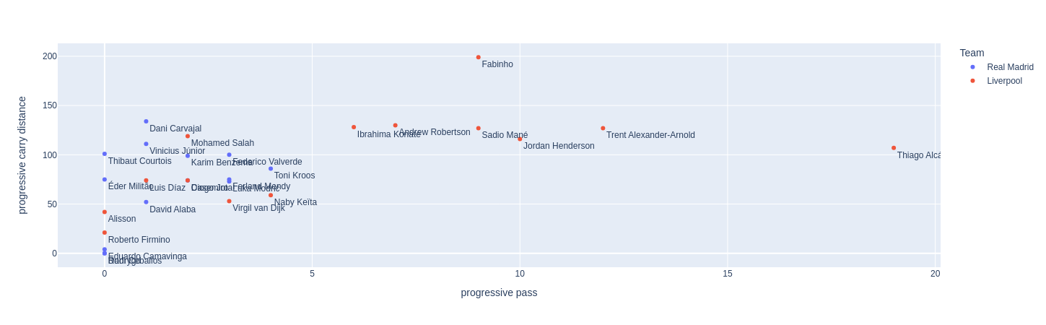
Progression stats: Mixed

Slide 13

Thanks for your attention!

